Slide 1
Week 3 – Principles of Design
ARTS 1301 Art Appreciation

Slide 2
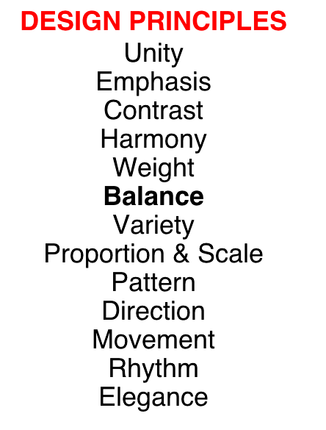

Slide 3
Balance

Slide 4
Balance is one of the most important design principles. Every proper composition must have its elements in one of the types of balance. Balance in art refers to the sense of distribution of perceived visual weights that offset one another. We feel more comfortable--and therefore find it more pleasing--when the parts of an artwork seem to balance each other.

Slide 5
Balance, in art, has to do with how big, how many, and where the objects are in a composition. In art, balance has nothing to do with physical weight, but rather is about visual weight. If an artwork has more objects or larger objects on one side (or top or bottom) of the composition, the visual weight is "heavier" on that side of the piece.

Slide 6
If the visual weight appears heavier on one side or the other, or on the top or bottom, the artwork is usually considered "unbalanced”. The visual interest of the artist's use of the Elements (if the artist uses an eye-catching texture or a bright color, for example) will also make the visual weight appear heavier, as well.

Slide 7
Symmetrical Balance: A composition that has the same Elements or imagery on both sides has symmetrical balance. If an object or artwork has symmetry, it can be divided down the center with a line of symmetry. On both sides of the line of symmetry, the images are the same, but opposite. A good way to "test" for symmetry is to fold the image (or at least imagine you are folding it!) on the line of symmetry. If the Elements or images "match up" when the composition is folded, it's symmetrical

Slide 8
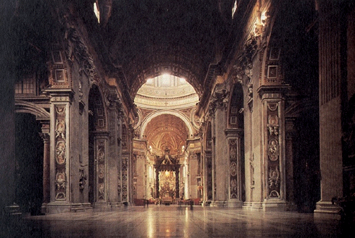
Symmetrical Balance,,

Slide 10
Remember that images on both side of the symmetry line don’t have to be exactly the same things — but the visual weight must be nearly the same.

Slide 11
Asymmetrical Balance: "Asymmetrical" simply means "not symmetrical." If a design or composition is asymmetrically balanced, it has more or larger or more interesting Elements or imagery on one side more than the other side, or more on the top than the bottom,. This informal balance is more intuitive. In the majority of applications, it is considered the most sophisticated and desirable.

Slide 12
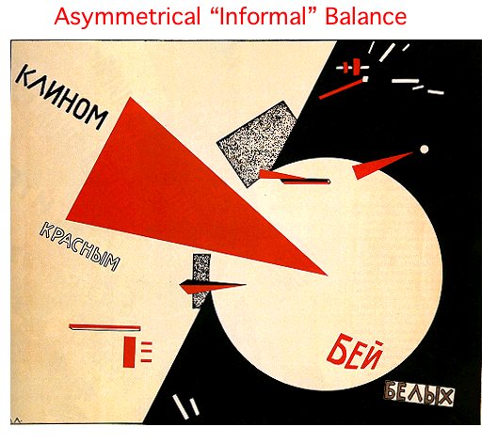

Slide 13
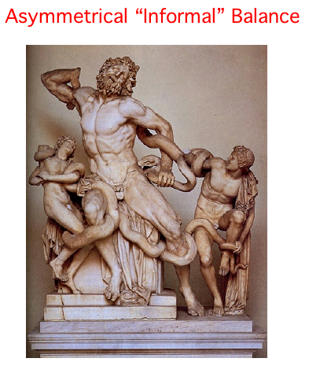

Slide 14
Radial Balance: Radially-balanced designs "radiate from" or "revolve around" a central focal point in the composition. A radially-balanced artwork is usually very dynamic

Slide 15
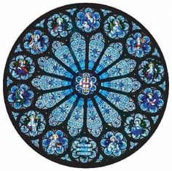
Radial Design

Slide 16
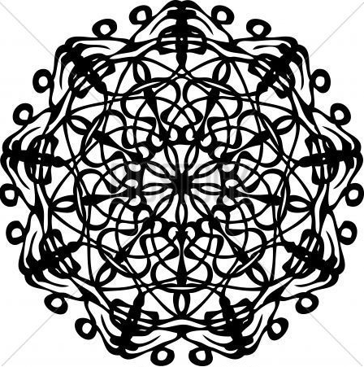
Radial Design

Slide 17
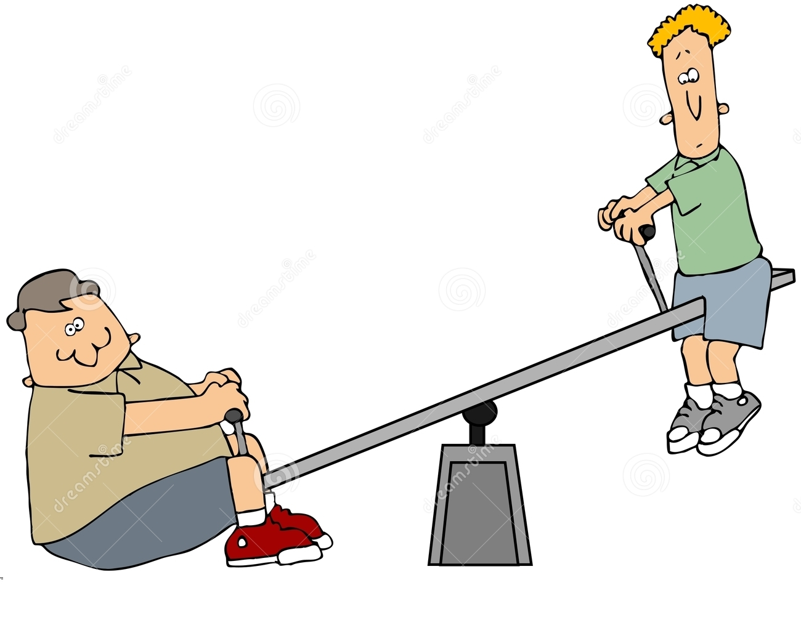
Our designs need to be in balace. We can compare visual balance to the teeter totter that uses a fulcrum lever and a pivot hinge.

Slide 18
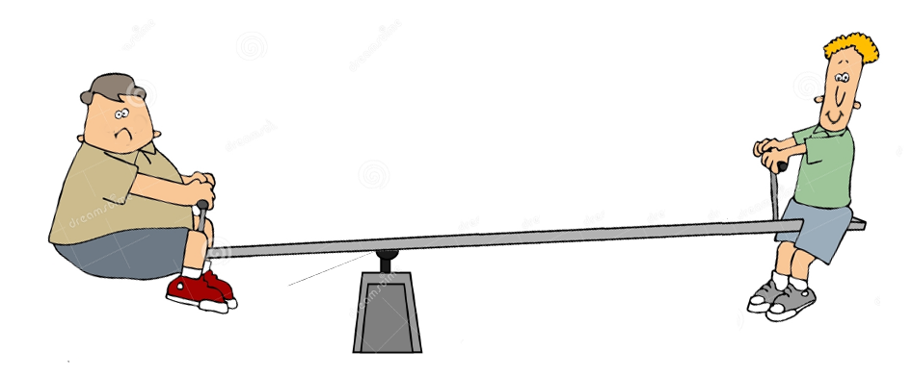
But if we extend the lever and slide our lighter weight boy out to the end, Leverage will lift up the heavier boy, giving us balance.

Slide 19
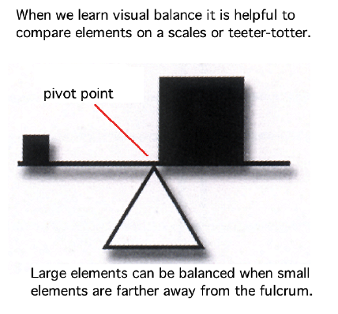

Slide 21
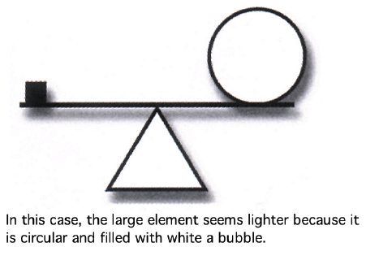

Slide 23
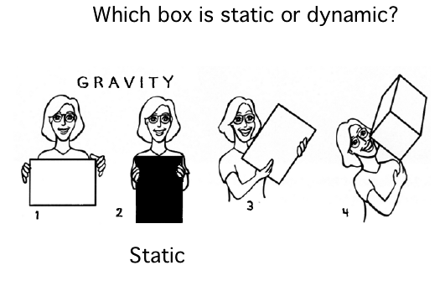

Slide 24
Principles of Design Unity
ARTS 1311 Design 1

Slide 25
Unity brings everything together. Unity is the relationship among the elements of a visual that helps all the elements function together. Without unity the other principles fall apart. Variety runs amok. Things that are supposed to balance are lost to sight. Without unity, we lose interest and concentration. The plan is fragmented and unintelligible.

Slide 26
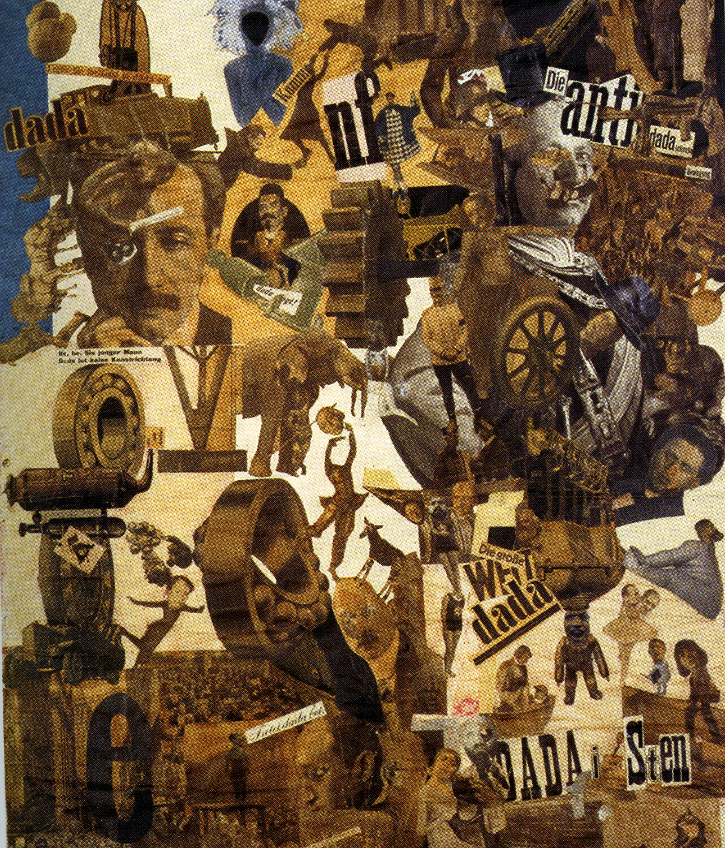
A very important principle of art, unity occurs when all of the elements of a piece combine to make a balanced, harmonious, complete whole. Unity is another of those hard-to-describe art terms but, when it's present, your eye and brain are pleased to see it. Unity is intuitive. Yet there as several way to achieve Unity…

Slide 27
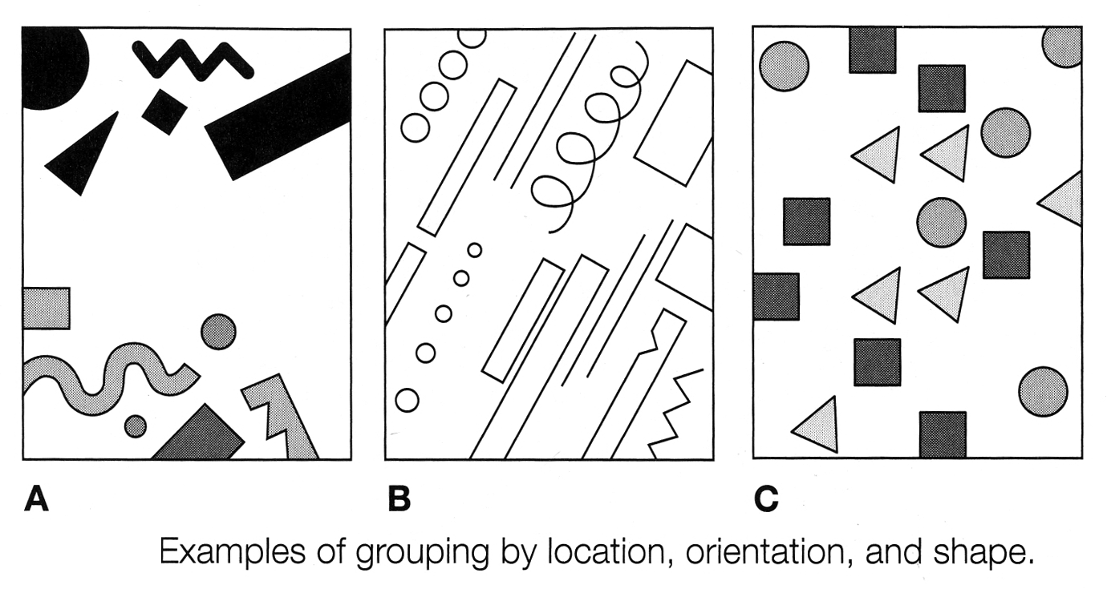

Slide 28
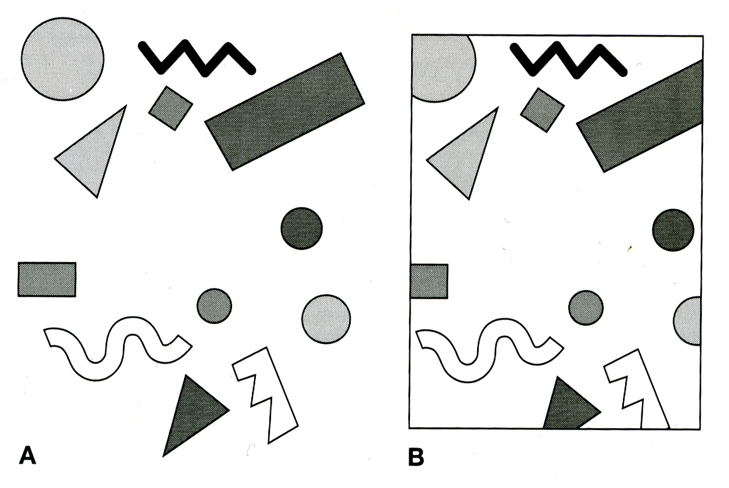
Unify objects through containment (framing) and cropping.

Slide 29
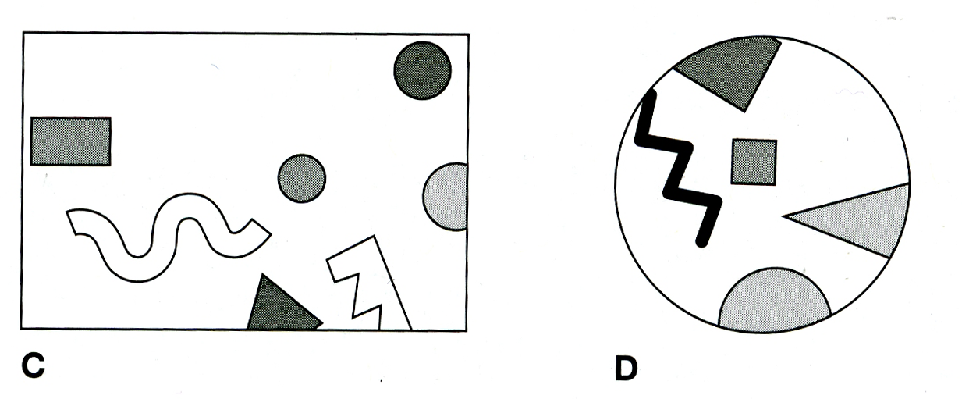
Unify objects through containment and cropping.

Slide 32
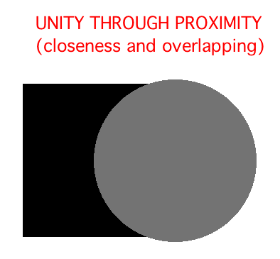

Slide 34
Principles of Design Emphasis
ARTS 1311 Design 1

Slide 35
Emphasis
Emphasis is contrast. It is the principle that allows an image to stand out from the rest, usually through contrast. The higher the contrast, such as black and white, the more the viewer’s eye will go to that area. Size can also create enough contrast to emphasize something. Often the larger the better. However a small item can be emphasized if the color or value contrast is great enough. Color, such as a singular red item, a yellow sun against a dark sky, or the use of complementary colors in contrast with each other.

Slide 36
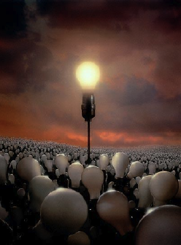
Emphasis is
Dominance
There are several ways to make an item or cluster of items stand out and dominate the design.

Slide 39
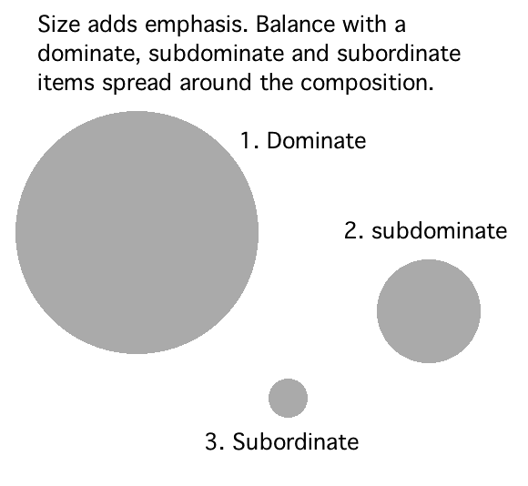

Slide 40
Size matters, and the larger black circle dominates and is emphasized

Slide 41
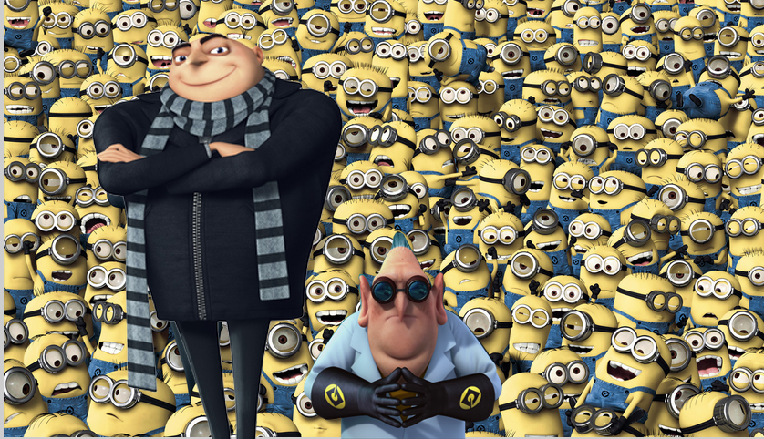
Dominate
Subordinates
(Evil Genius)
(Minions)
Sub-Dominate
(Side-kick)

Slide 42
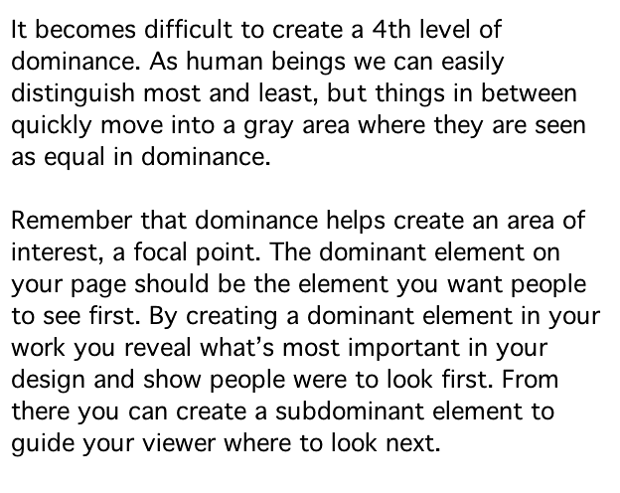

Slide 43
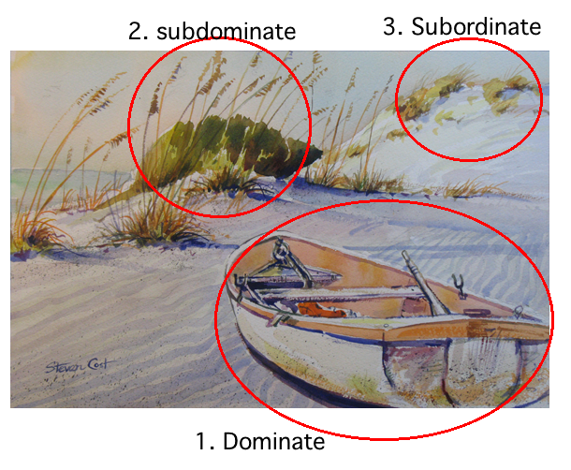

Slide 44
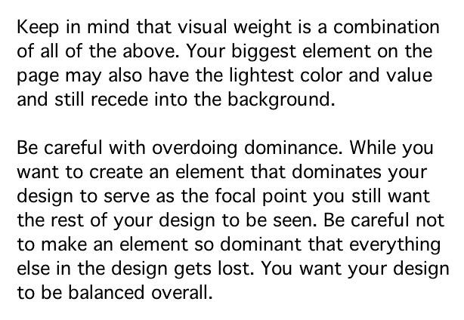

Slide 45
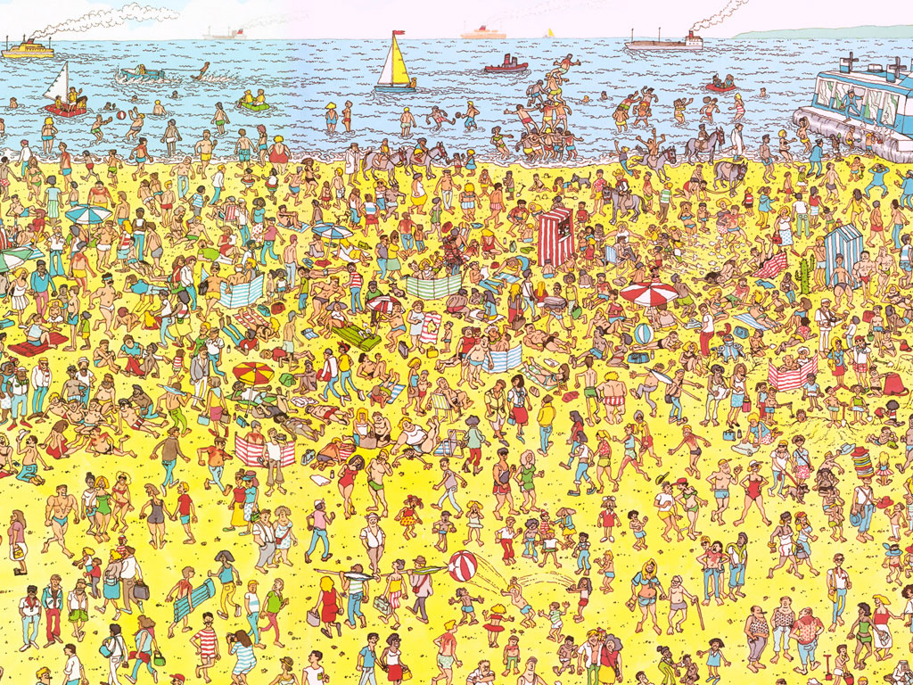
Where’s Waldo?
Emphasis is “getting to the point” when telling your design story

Slide 46
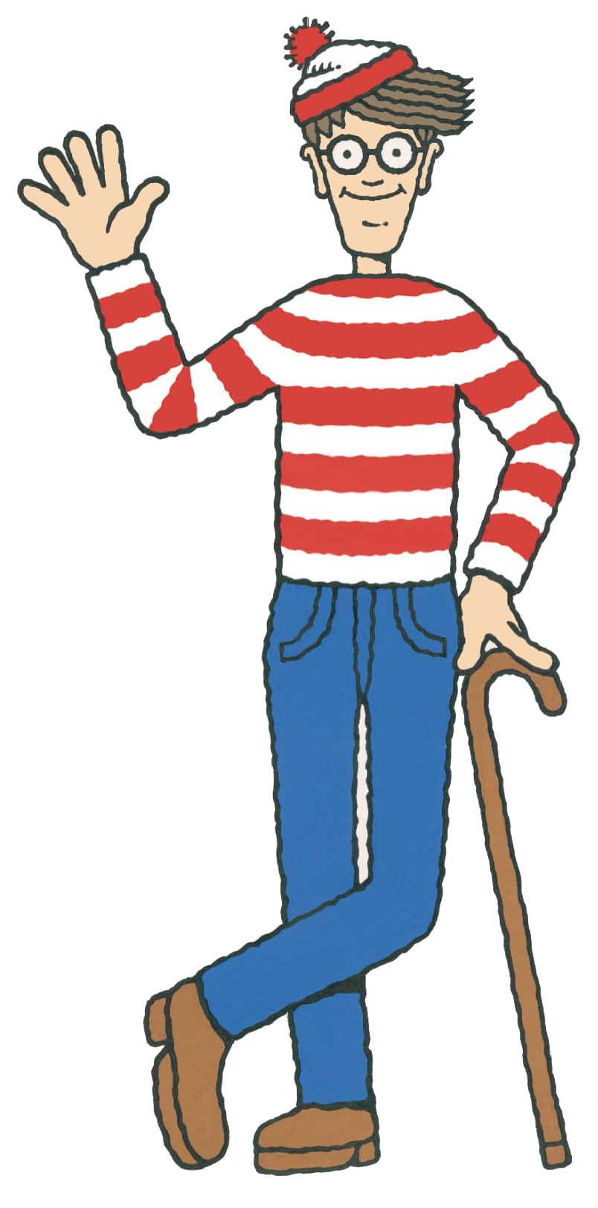
Here’s Waldo?

Slide 47
Principles of Design Repetition, Rhythm and Pattern
ARTS 1311 Design 1

Slide 48
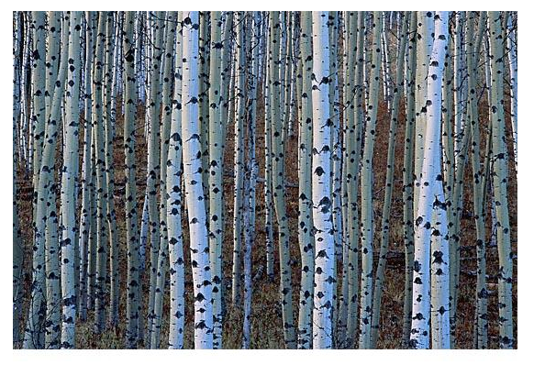
Repetition in nature is a common sight, from schools of fish to forests of trees.

Slide 49
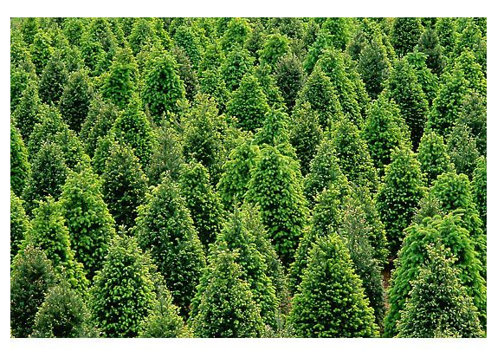
Repeating shapes and forms without variation can be taken in with one glance. The brain comprehends one and immediately knows the rest are identical..

Slide 50
Due to constant exposure, our hard-wired response is to always expect Repetition to be accompanied by variation. The important thing to notice with natural repetition is the presence of variation which makes repetition more rhythmical and interesting.

Slide 51
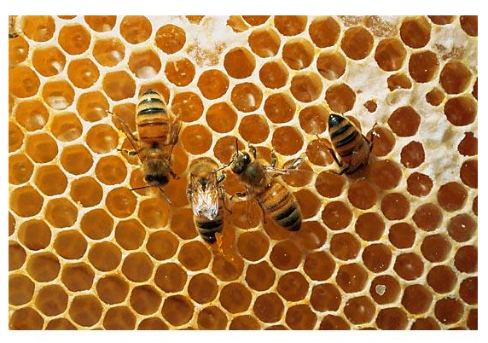
When variation is introduced, subconscience mental activity is required to absord the repeating elements. This relieves monotony and adds interest, even when the variation is subtle.

Slide 52
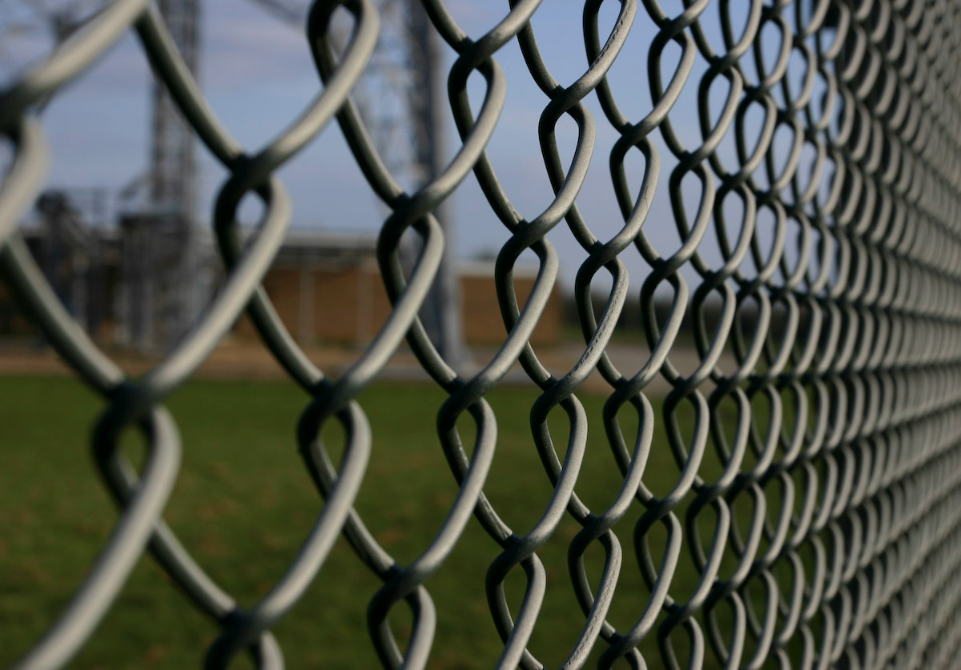
Due to constant exposure, our hard-wired response is to always expect repetition to be accompanied by variation.

Slide 53
The important thing to notice with any repetition is the presence of variation which makes repetition more rhythmical and interesting.

Slide 54
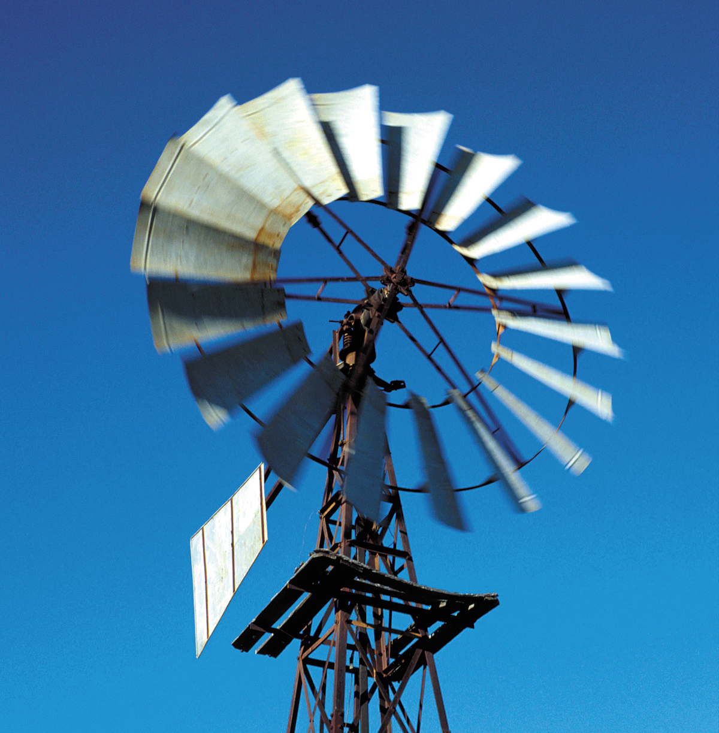

Slide 55
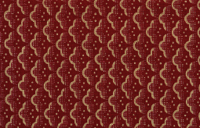
Repetition without variation becomes Pattern and moves more into the realm of what was considered decorative art.

Slide 56
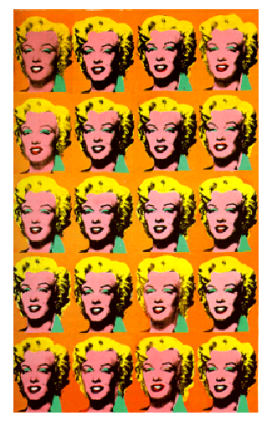
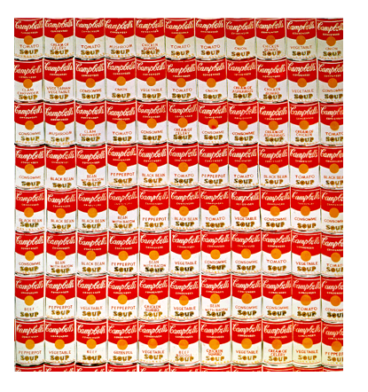
However many of the pop artists incorporated pattern into fine art, a trend that has continued into the contemporary art practice of today.

Slide 57
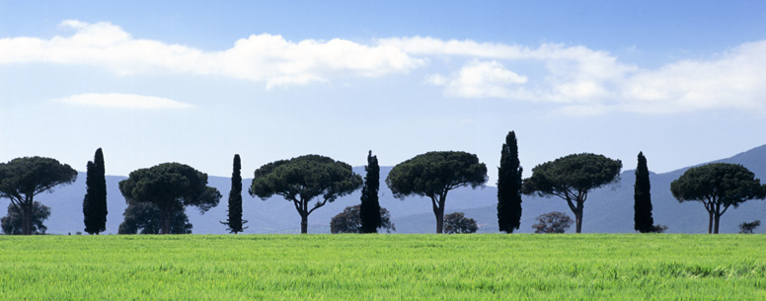
Rhythm relieves monotony of mere repetition. Like with music sequences of shapes and forms are repeated with sophistication.

Slide 58
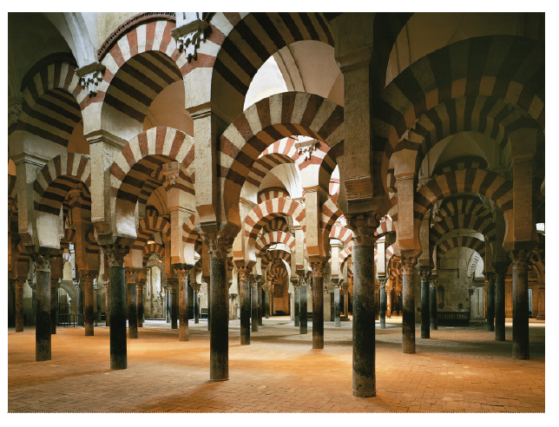

Slide 59
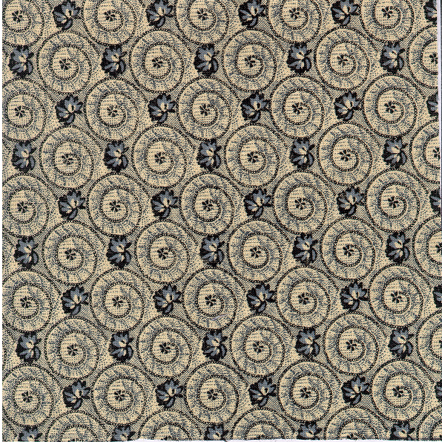

Slide 60
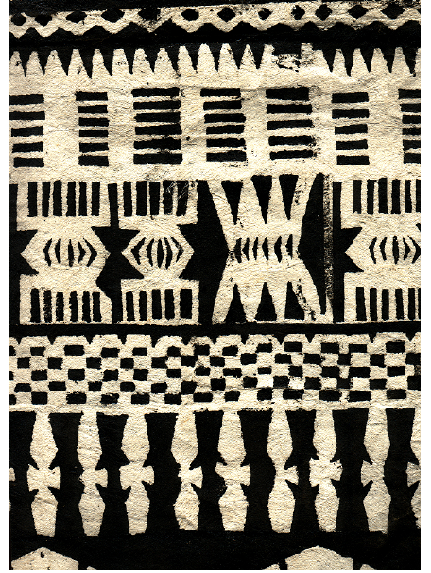

Slide 61
Principles of Design Proportion & Scale
ARTS 1311 Design 1

Slide 62
Proportion is the comparison of one thing to another, specifically the size of one thing compared to another. Parts of the body are in proportion to each other. The hand is about the size of the face. If a nose is very large and out of proportion it is very noticable.
Scale is the comparison of a thing to the siae of a human being. It may also be compared to things that are a standard size to a human. The size of a chair must be in scale to the human who will sit in it.

Slide 63
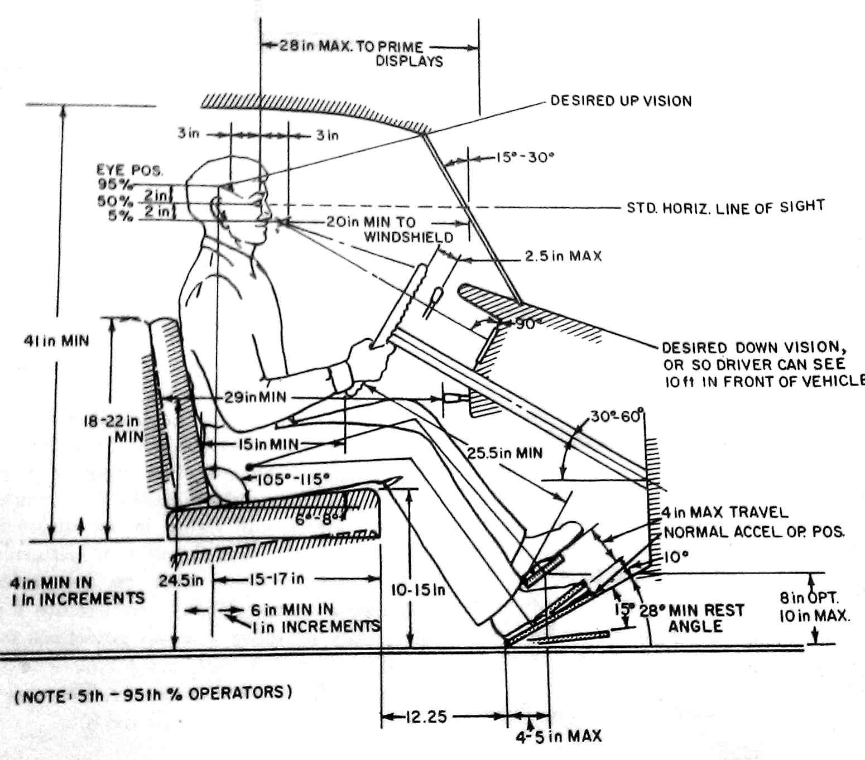

Slide 64
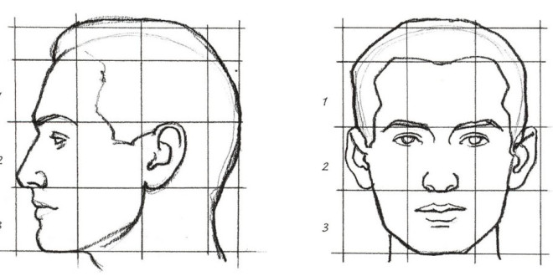
Comparitive proportions of parts of the face

Slide 65
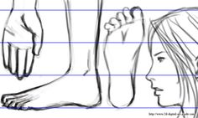
Comparitive proportions of parts of of the body

Slide 66
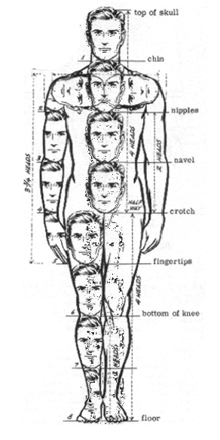
Proportion of the parts of the human body. The ideal height of a male human is eight heads tall.

Slide 67
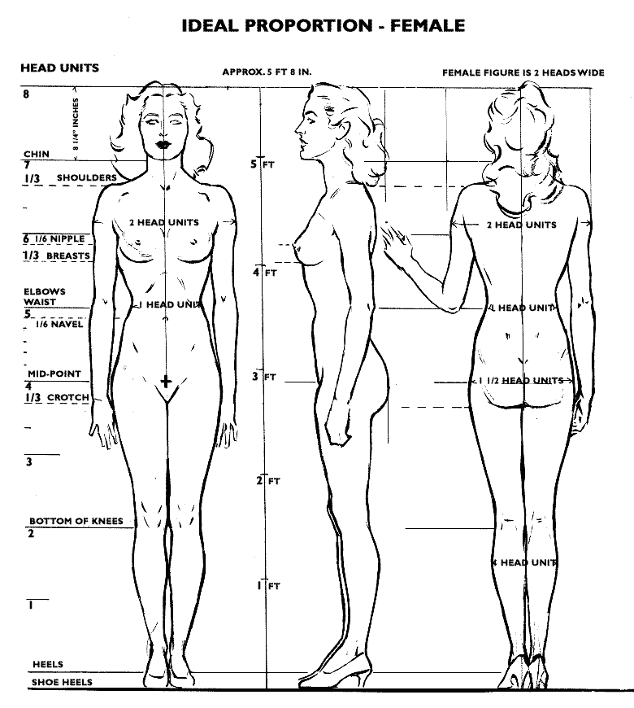

Slide 68
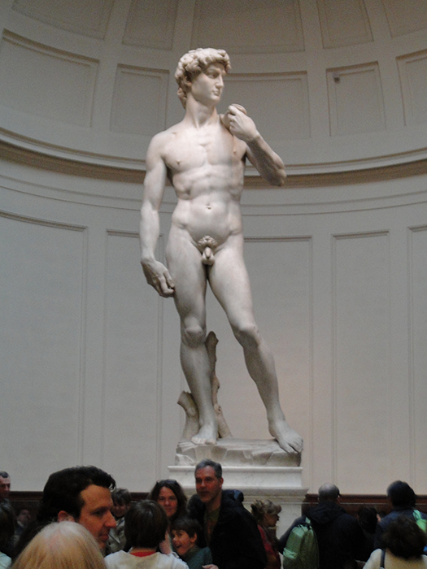
Artists have created works of monumental proportions to give greater importance to the subject.
David by Michaelangelo. Academia Gallery, Florence
Photo by Steven Cost

Slide 69
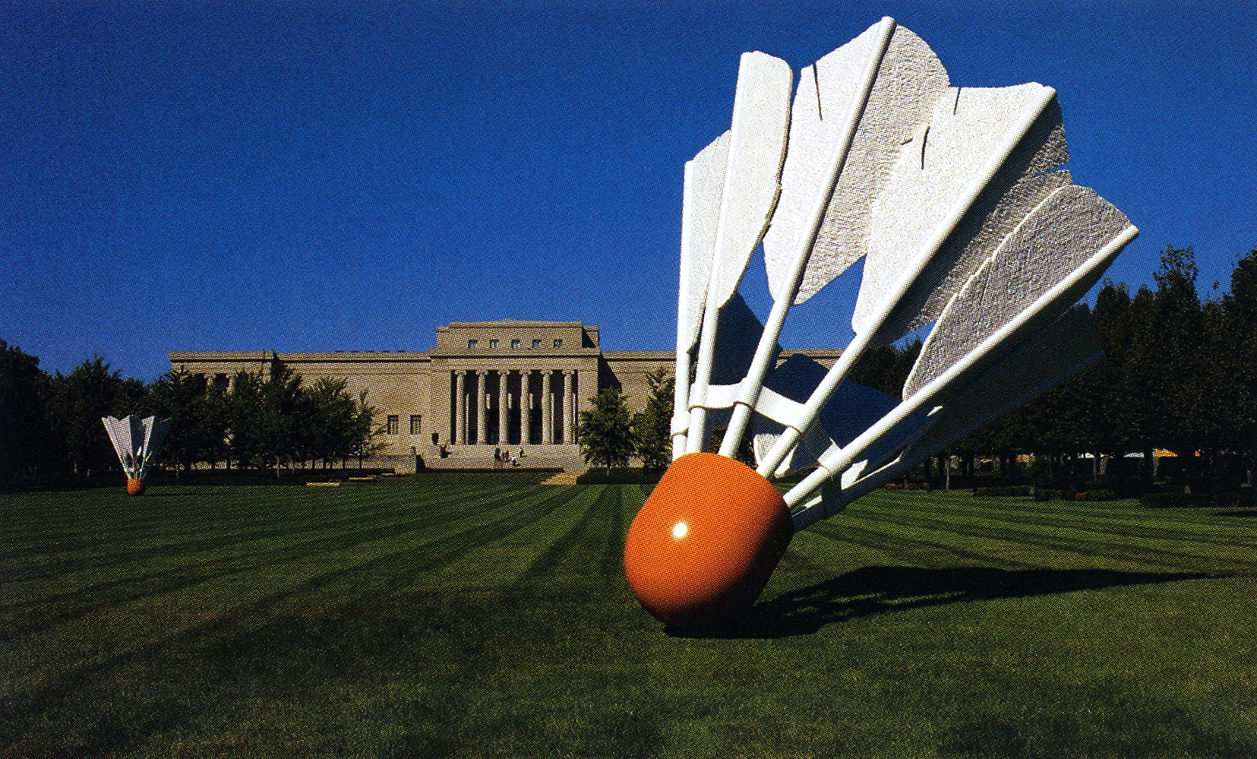
Artist have long distored the proportions of objects. This badmitton shuttlecock is 14 feet tall when a normal one fits in the palm of a hand.

Slide 70
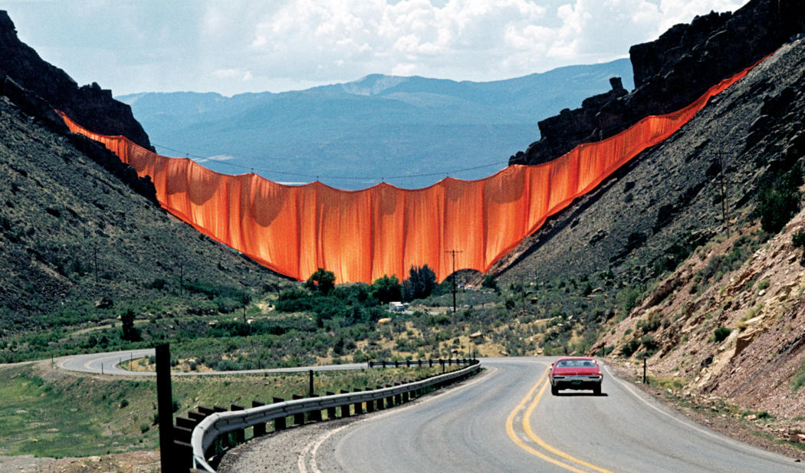
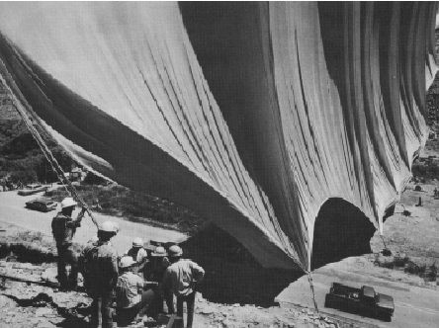
Monumental and extremely out of scale is Valley Curtain by Christo and Jeanne Claude

Slide 71
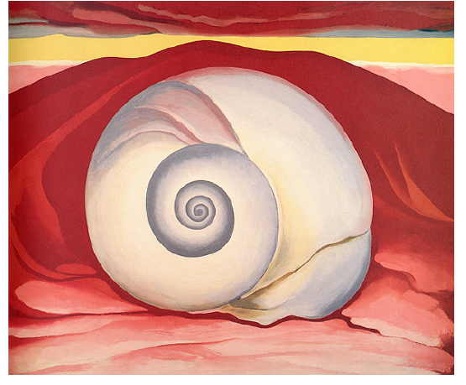
Proportion may be ambiguous like in the painting Red Hill White Shell by Georgia O’Keefee.

Slide 72
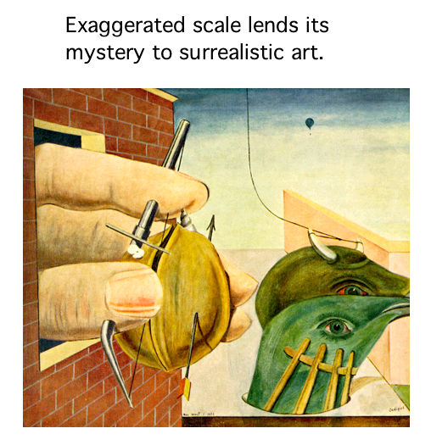

Slide 73
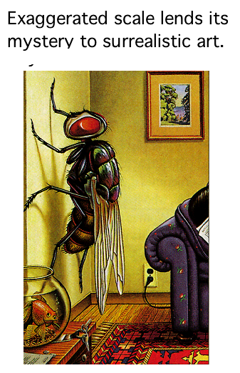

Slide 74
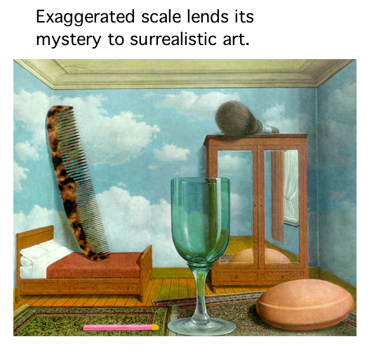

Slide 75
Principles of Design Movement & Direction

Slide 76
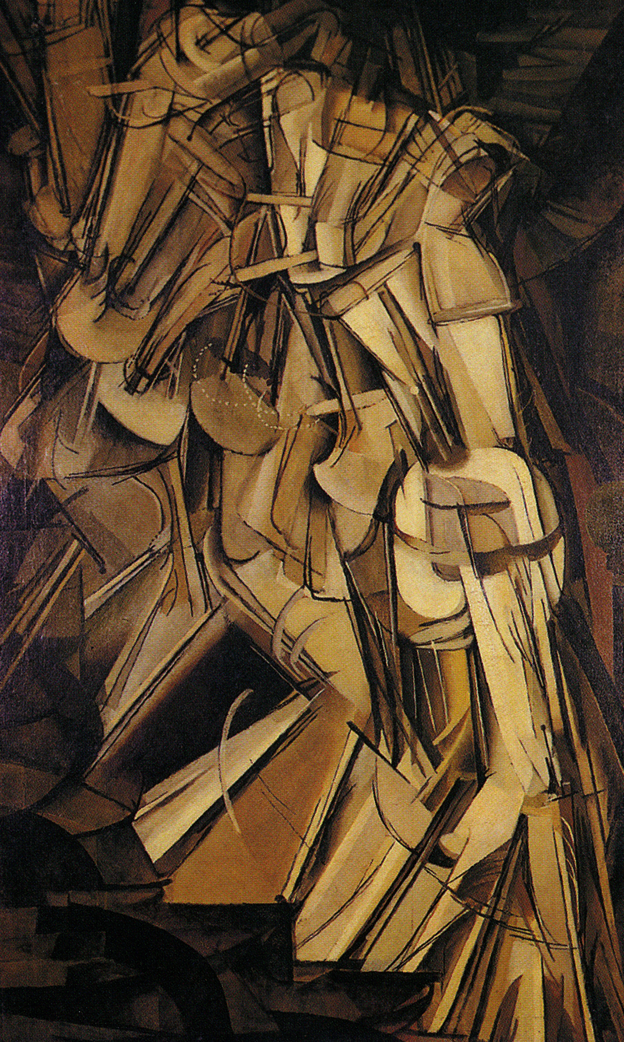
Direction is dependent on the elements and other principles of design, especially contrast and emphasis.
Westerners tend to read left to right and top to bottom, so this will greatly influence where they feel the most comfortable starting (upper left) and ending up (lower right) in the design.

Slide 77
If visual weight is about attracting the eye to a particular location, then visual direction is about leading the eye to the next location. Visual direction is the perceived direction of visual forces. Think of it as the direction you would expect an element to move if it were in motion.

Slide 78
Line is probably the easiest way to guide the viewer through a design. Arrows (vectors) are commonly used to point to important information or to the next area. Be careful, though, because using line conspicuously like this can be unsophisticated and maybe even condescending..

Slide 79
Linear direction

Slide 80
Implying Motion in a static image is similar to freezing the action. Motion will also have a direction into which to move.

Slide 81
Frozen motion

Slide 82
Motion effects

Slide 83
Principles of Design Harmony
ARTS 1311 Design 1

Slide 84
Harmony is the pleasing relationship between elements such as color, value, and shape. Harmony in art and design is the visually satisfying effect of combining similar, related elements. For instance, adjacent colors on the color wheel, similar shapes etc. In color there are color schemes, such as analogous, complementary, and monochromatic color schemes, that assure color harmony.
Analogous color scheme with appropriate type for the modern graphics

Slide 85
Shape and color harmony

Slide 86
Harmony using cool analogous colors and similar organic shapes — like a pleasing harmonic musical chord.
Art by Steven Cost

Slide 87
Type and image Harmony
Select harmonious and appropriate type faces for the subject

Slide 89
Color Harmony

Slide 90
Color Harmony
Complementary Color
Semi-Neutrals
Making neutral lifeless gray and semi-neutrals with complementary colors
Blue-Green
Red-Orange

Slide 91
Complementary Color
Semi-Neutrals

Slide 92
Complementary Color

Slide 93
Color Harmony
Analgous Colors
Mix only the semi-neutrals from neutral to the pure hue of the
analogous colors.

Slide 94
Color Harmony
Analgous Colors

Slide 95
Color Harmony
Triadic Colors

Slide 96
Color Harmony
Triadic Colors

Slide 97
Principles of Design Variety

Slide 98
Variety is the al-you-can-eat buffet, that provides many choices. Try them all of have more of one. Variety is “the spice of life” they say, and life would be bland and boring without variety. Variety in design includes the elements such as a variety of lines, shapes, and colors. It also includes the principles using emphasis, balance, and movement. Its challenging using variety and keeping unity.

Slide 99
Variety of values, textures, shapes, colors, lines and direction and movement — all together heighten our interest.

